Slide 1
Assignment-1
Keshav Gambhir (2019249)
Tanmay Rajore (2019118)

Slide 2
Polyalphabetic Substitution Cipher
Monoalphabetic substitution with increased number of substitutions
p = p0p1p2…….pn
k = k0k1k2……..km
Making the length of k equal to length of p
c = (p0+k0)(p1+k1)......(pm+km)(pm+1+k0).......(p2m + km)…..
c → cipher text
pi → alphabet in plain text
ki → alphabet in key
+ → modulo 26 addition

Slide 3
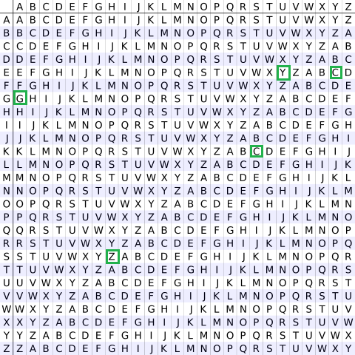
Vigenere Cipher

Slide 4
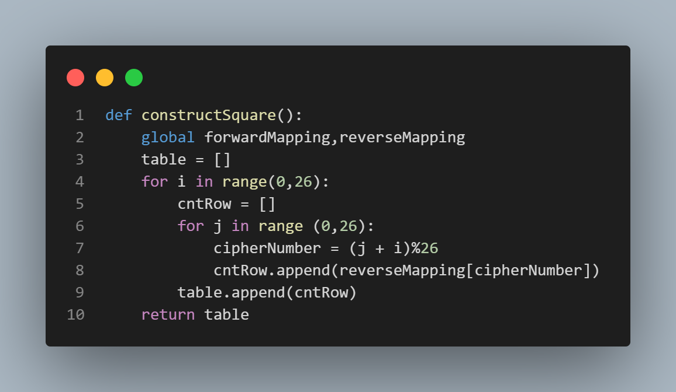
Construction of Vigenere Cipher Table

Slide 5
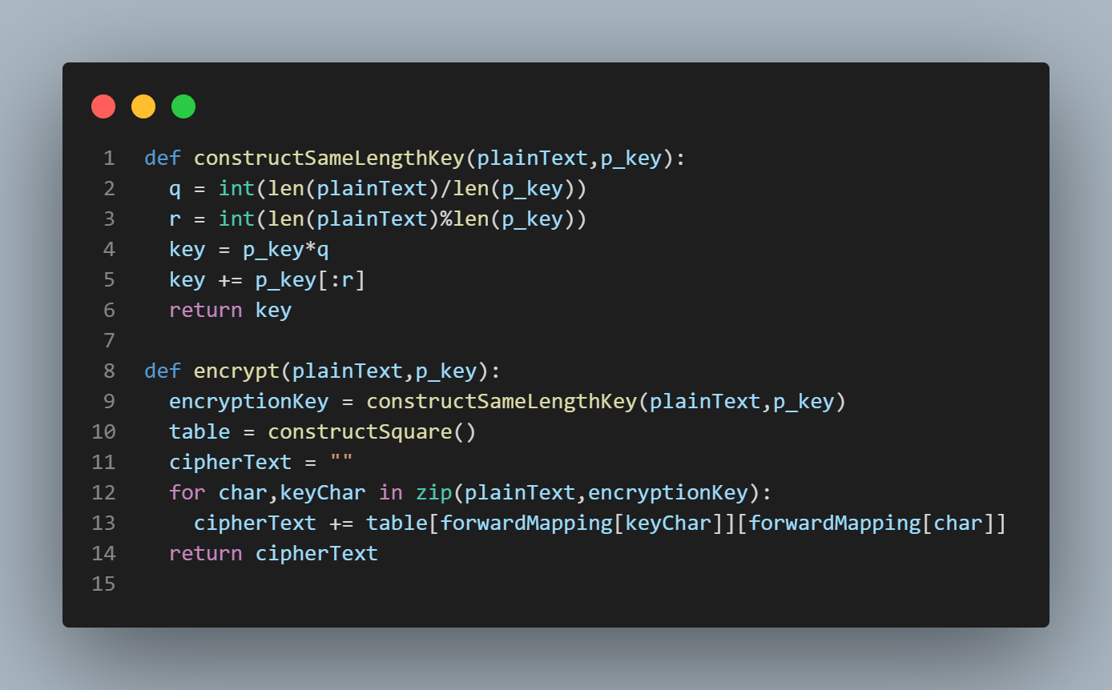
Encryption Algorithm

Slide 6
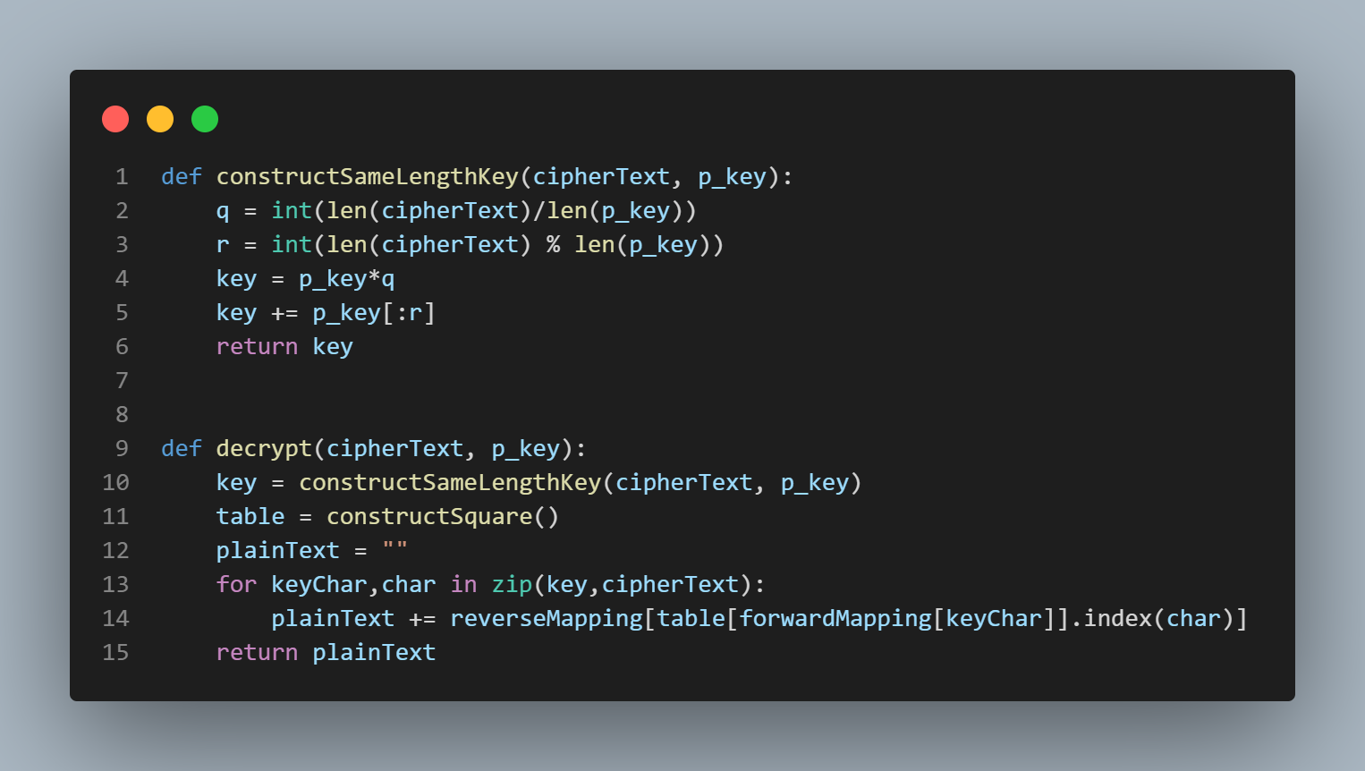
Decryption Algorithm

Slide 7
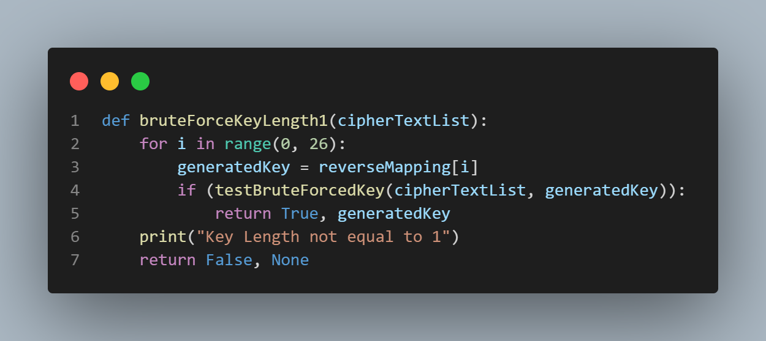
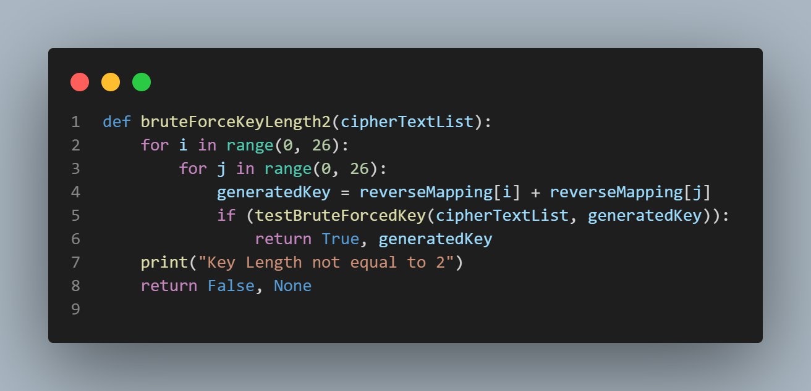
Brute Force Algorithm

Slide 8
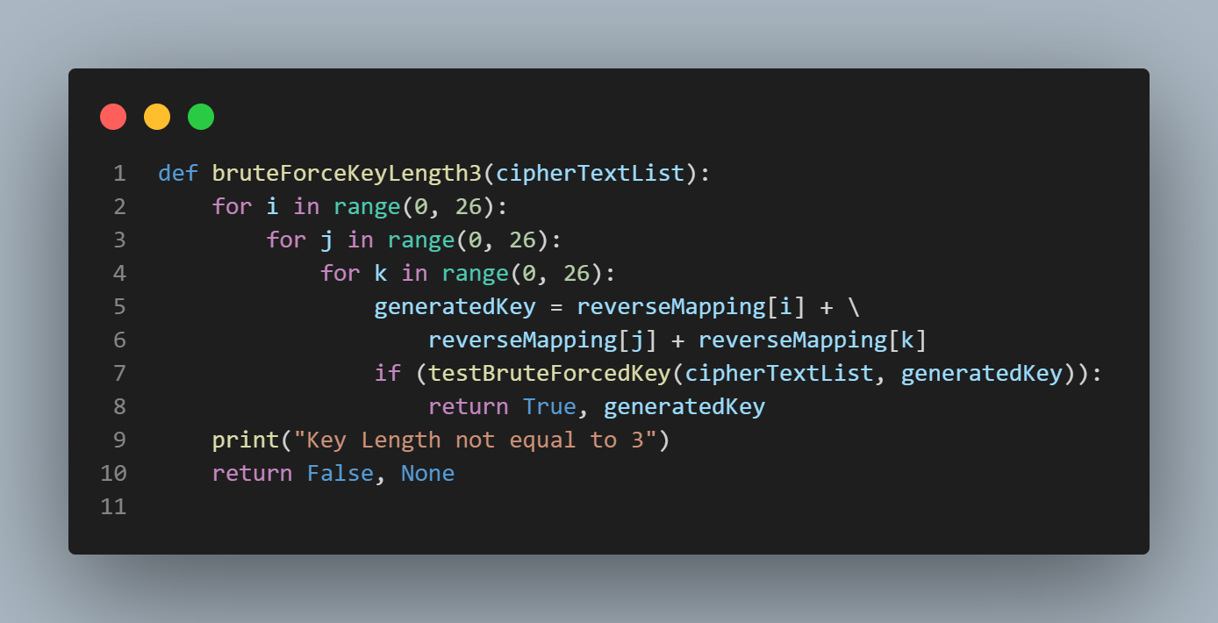
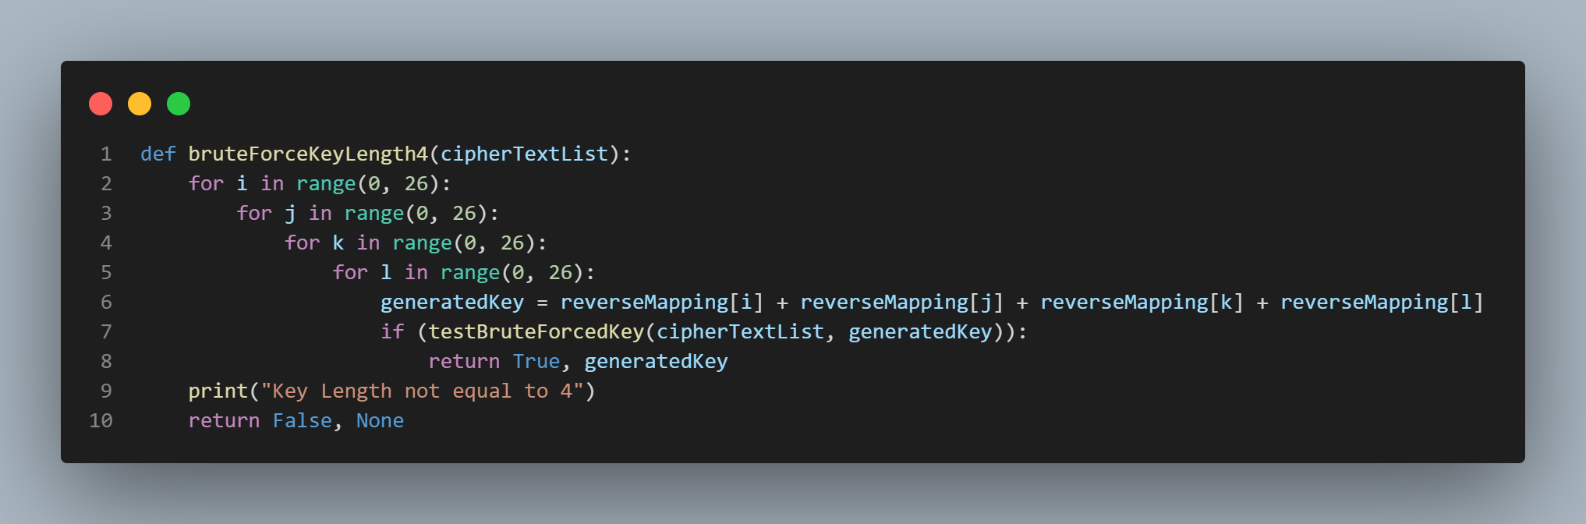

Slide 9
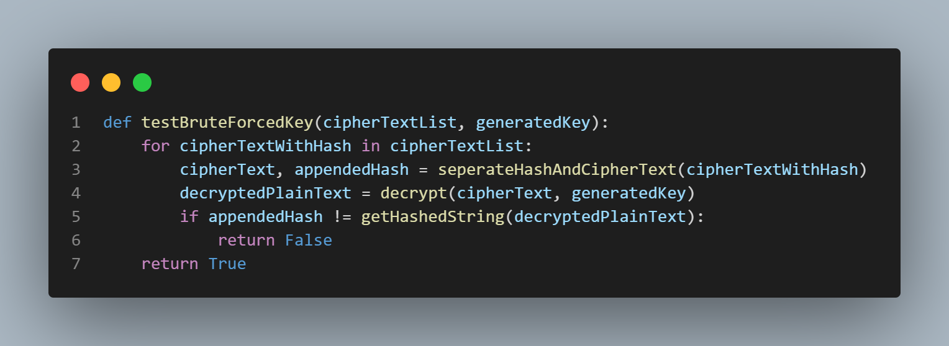
Key Testing

Slide 10
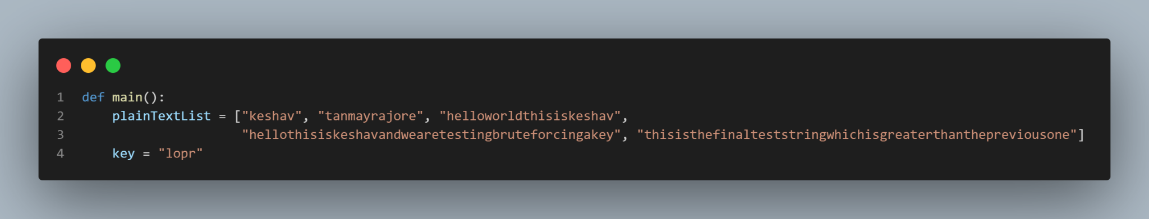
Chosen Test Cases and key

Slide 11
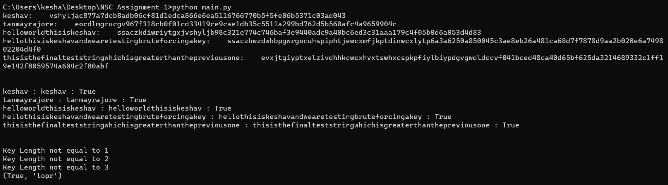
Result

